Slide 1
Machine bias in Mortgage
Jackson Hu, Maria He, Jiayu Wang, Yijia Yang, Yuning Zhao
Notes:
YZ

Slide 2
Problems with AI Bias
ML models learn to use data to:
Make decisions
Perpetuate the original biases in the data
Fairness-accuracy trade-off
Notes:
YZ: Removing these variables makes the models fairer but less accurate in prediction.
ML practitioners should take data ethics into account in models.

Slide 3

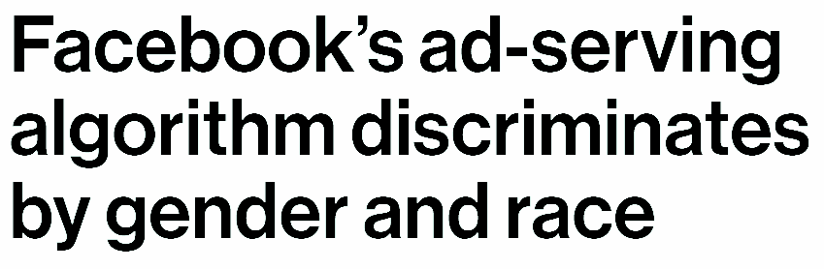

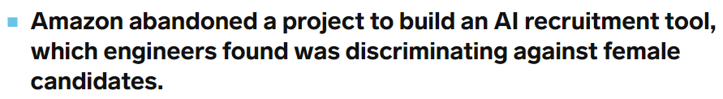
Problems with AI Bias

Slide 4
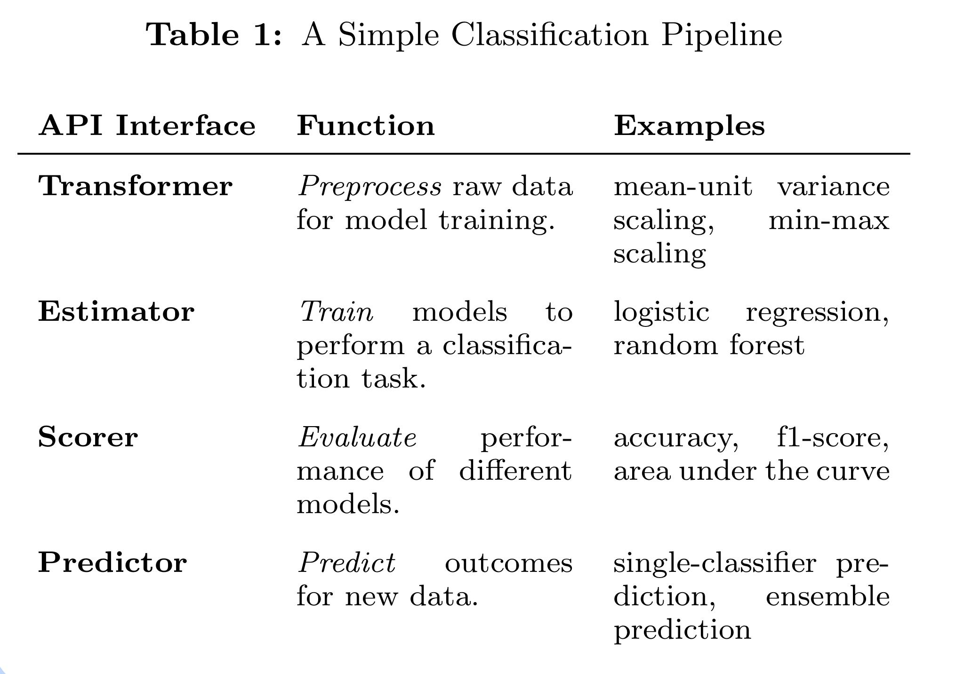
Themis-ML
Aims to reduce bias but retain accuracy. It modifies the machine learning pipeline at various stages for discrimination detection and fairness in predictions.
Notes:
Yijia

Slide 5
Methods used to reduce machine bias
1. Remove Protected Attribute (RPA)
2. Relabel Target Variable (RTV)
3. Additive Counterfactually Fair Model (ACF)
4. Reject-option Classification (ROC)
Notes:
Yijia

Slide 6
Background on the dataset
A research-ready data set of U.S. home mortgage loan applications, based on data from the federally mandated Home Mortgage Disclosure Act. In 2014, there were about 11.7 million loan records. These records include applications for home purchase, for home improvement, and for refinancing.
We explore this US national mortgage dataset and build predictions for loan approvals or denials.
Notes:
Jiayu measure discrimination optimize fairness&accuracy
(11,million, 53)

Slide 7
Data Cleaning
Subset data with random sampling
Drop repeated columns
Get dummies of categorical columns
Come up with variables that tend to create bias:
Gender
Ethnicity
Race
Notes:
Jiayu
(11,million, 53) (3,million, 66) y: ACTION---loan approvals or denials
Identified Protected classedl

Slide 8
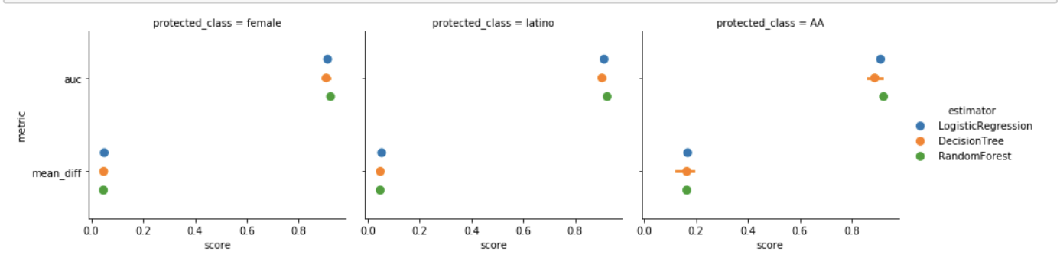
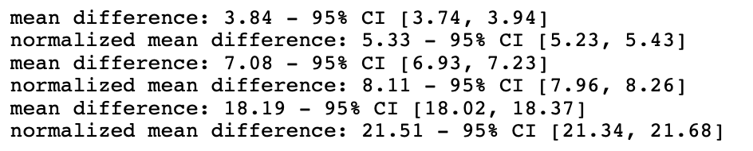
Establish Baseline Metrics
Female
Latino
AA
Notes:
Maria

Slide 9
Groups of Interest - Protected Class
protected class = female:
best utility measured by auc (higher is better) = 0.923: RandomForest
best fairness measured by mean_diff (lower is better) = 0.047: RandomForest
protected class = latino:
best utility measured by auc (higher is better) = 0.923: RandomForest
best fairness measured by mean_diff (lower is better) = 0.048: RandomForest
protected class = African American:
best utility measured by auc (higher is better) = 0.923: RandomForest
best fairness measured by mean_diff (lower is better) = 0.156: RandomForest
Notes:
Maria
We use mean difference as the “fairness” measure and AUC as the “utility” measure. The former represents the degree to which potential discrimination patterns in data are learned by the ML model, and the latter represents the predictive power of a model given the available dataset.

Slide 10
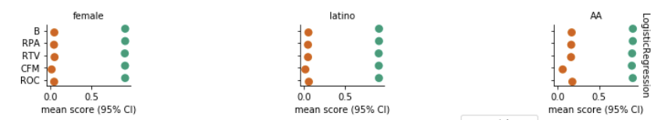
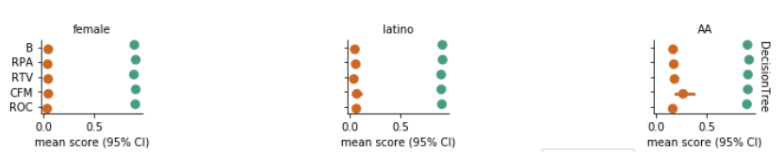
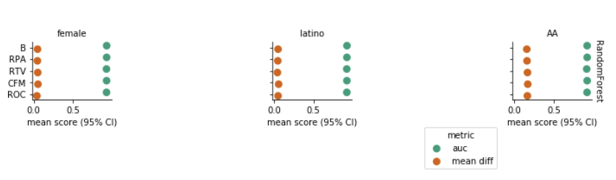

Slide 11
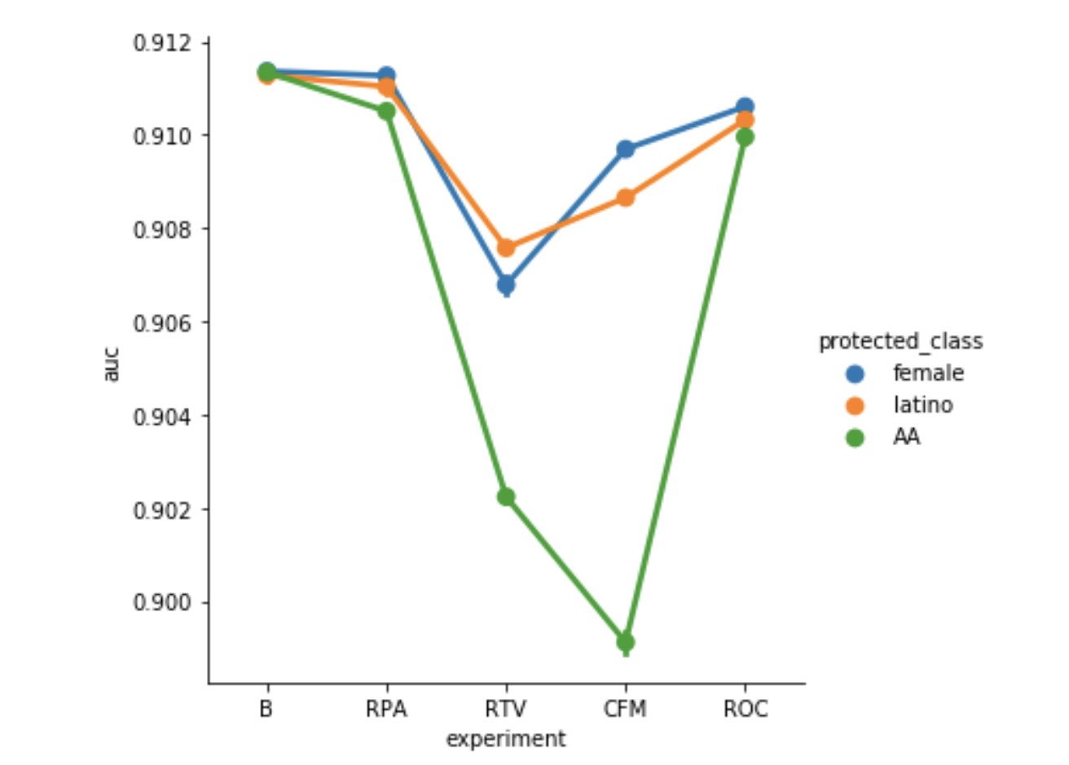
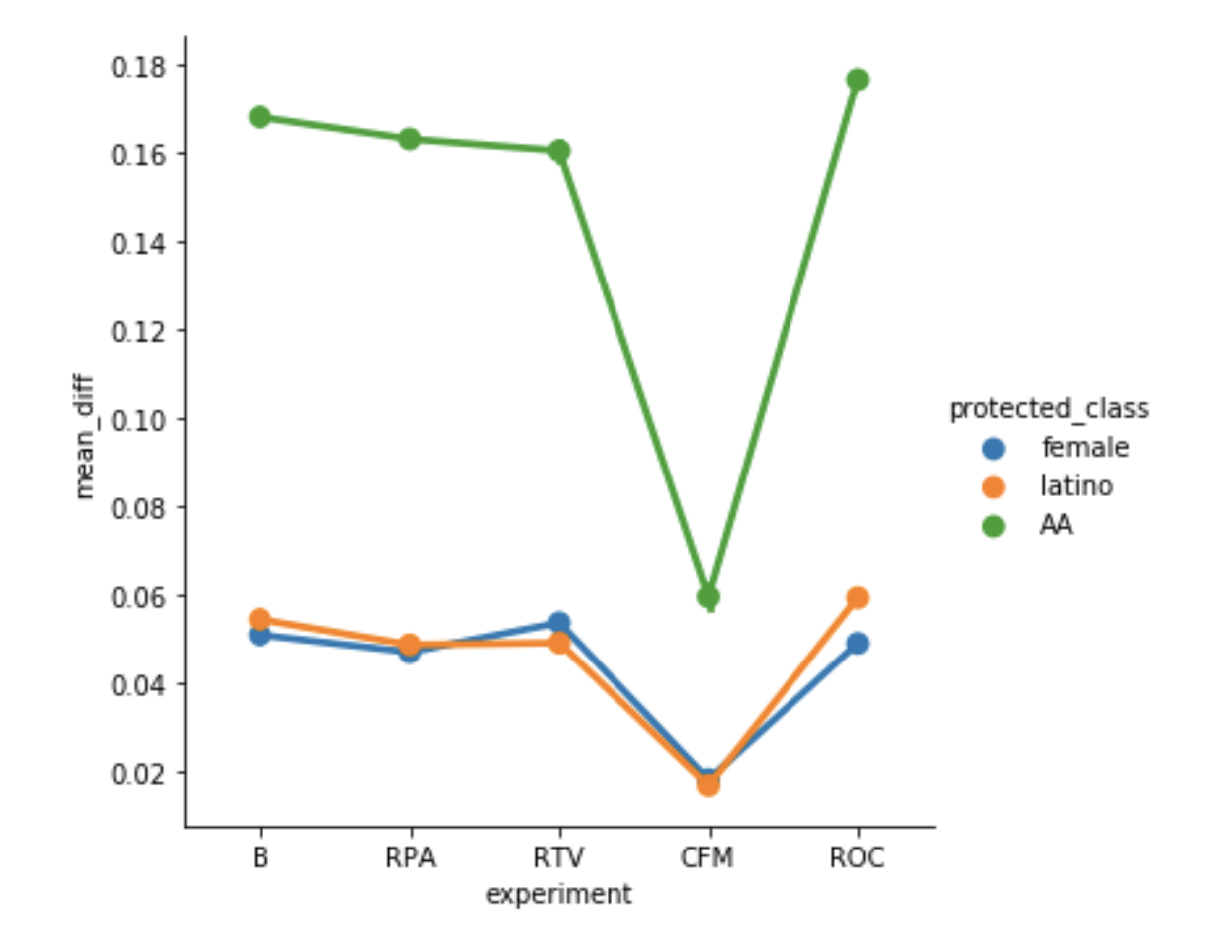
Findings
B
B
Notes:
Maria
RPA auc: 0.1% md: 1%
RTV auc: 1% md: 1%
CFM auc:1.2% md: 62.5%

Slide 12
Learnings & Recommendations
Learnings:
Method result varies
Trade-off
Recommendations:
Collect more features
Run models on larger dataset
Notes:
Machine has bias. ML practitioners should take data ethics into account in models.
ML models learn to use data variables to make decisions and perpetuate the original biases in the data. Removing these variables makes the models fairer but less accurate in prediction. This is the fairness-accuracy tradeoff.

Slide 13
Limitation
“Fairness”
Relabelling
Limitations within bias adjusting methods
ACF
ROC
Notes:
Relabelling fairness:
Has a narrow definition of what fair is:
Uniform definition of benefits between the X variables of advantaged and disadvantaged group
Also it directly changes the y value for advantaged and disadvantaged group to make the dataset more “fair”
ACF issues: only works for linear regression-once we introduce a nonlinear relationship the method becomes unstable
ROC : only a selected number of classifiers can be applied with this method: it requires the classifier to produce a predicted probability.

Slide 14
Q&A
Thank You!

Slide 15
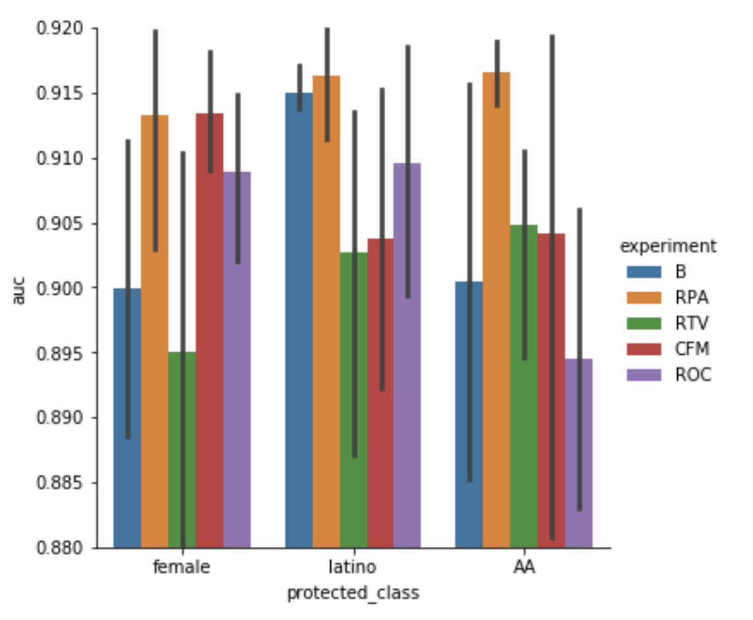
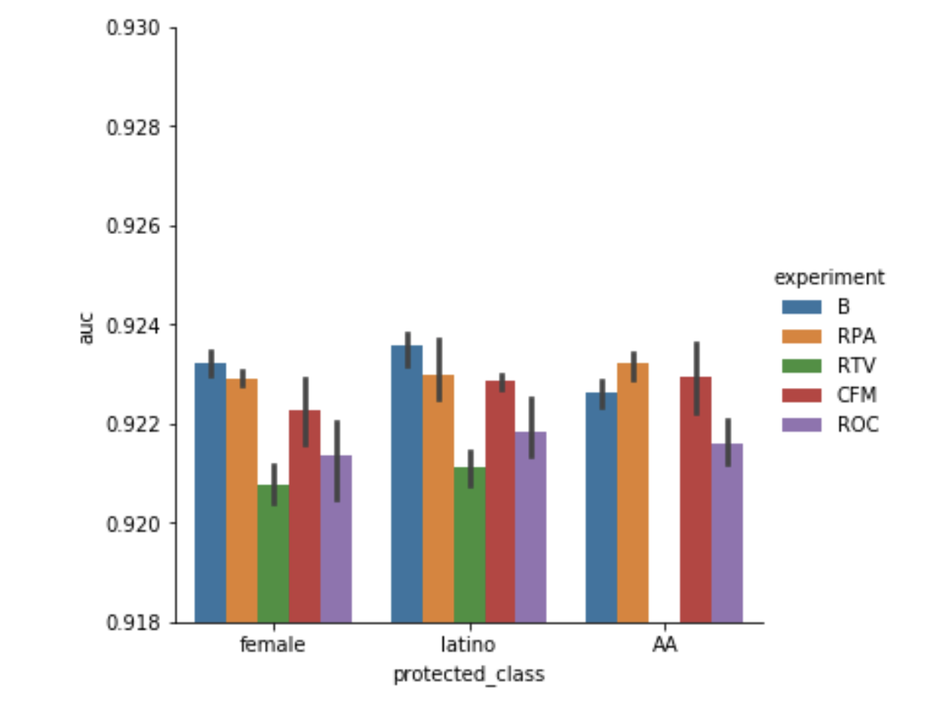
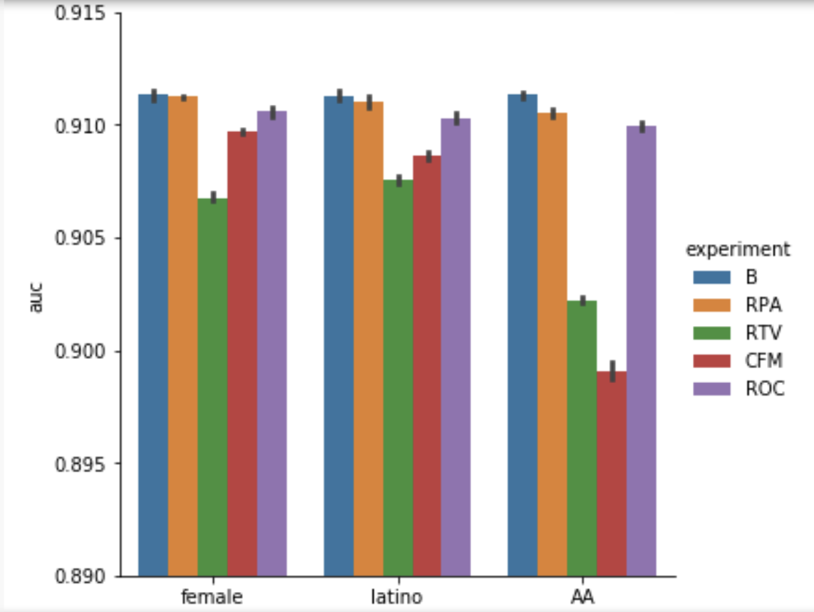
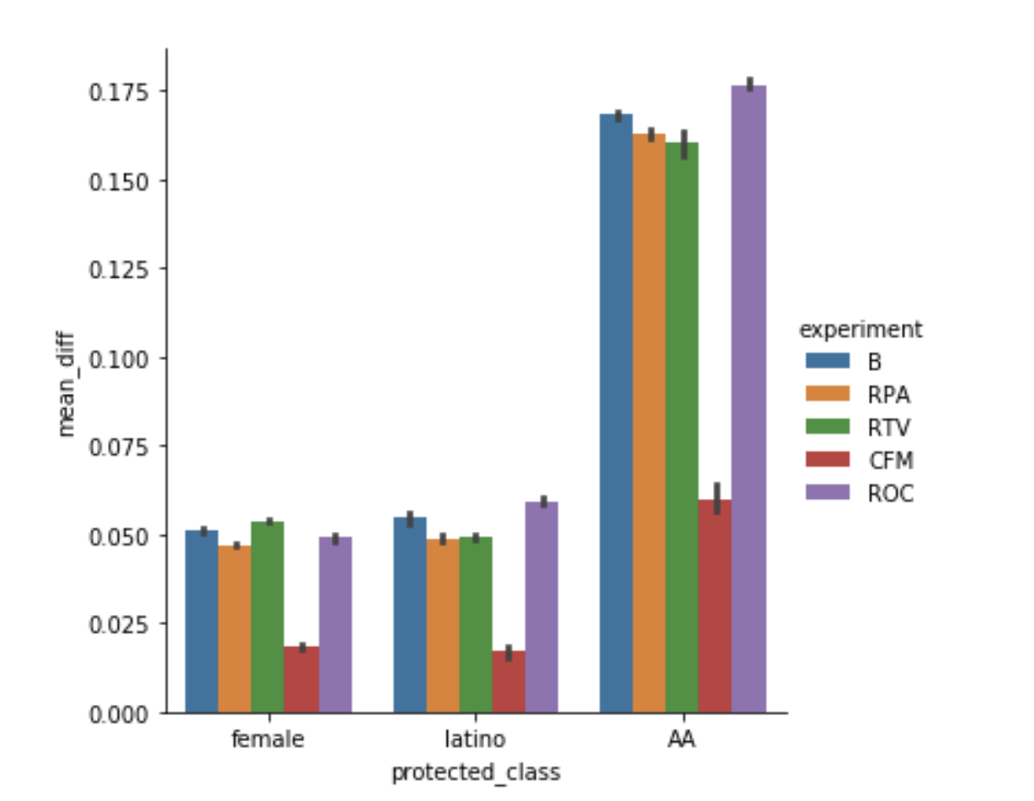
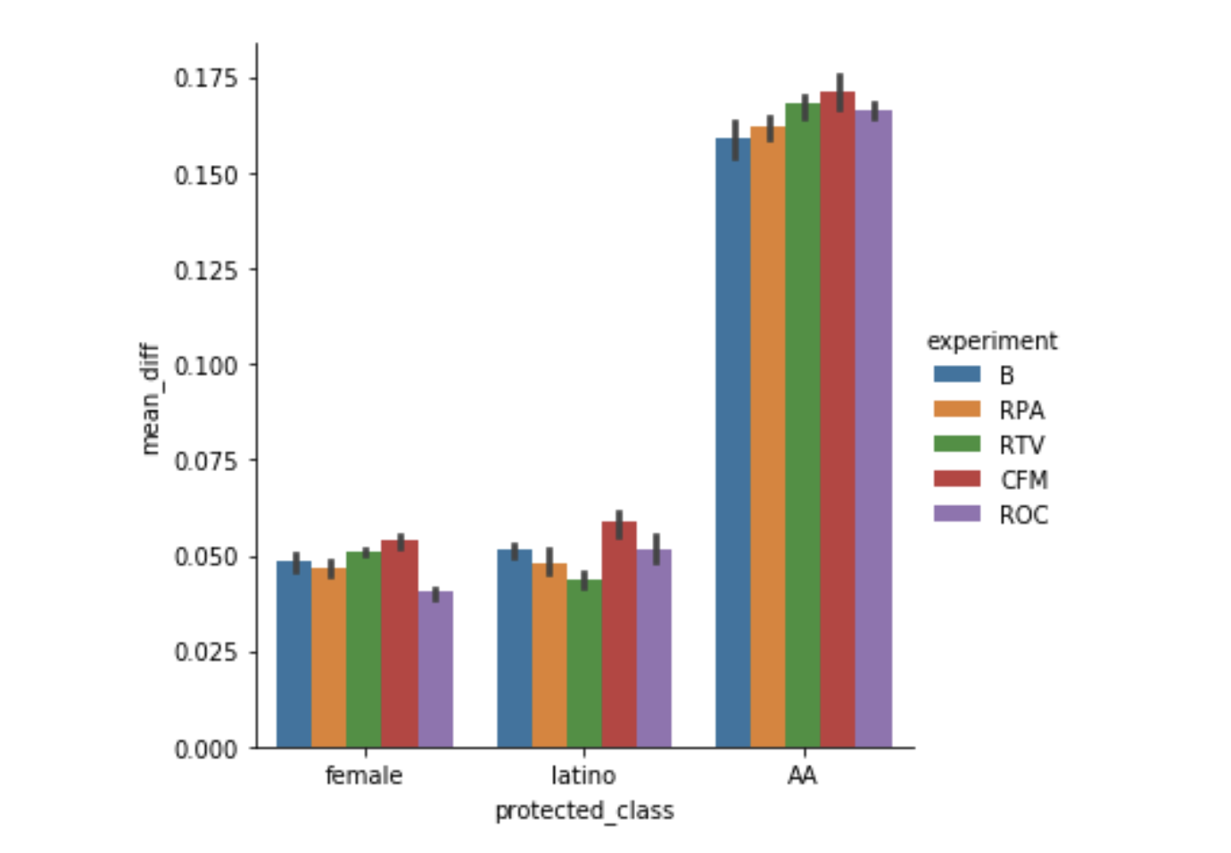
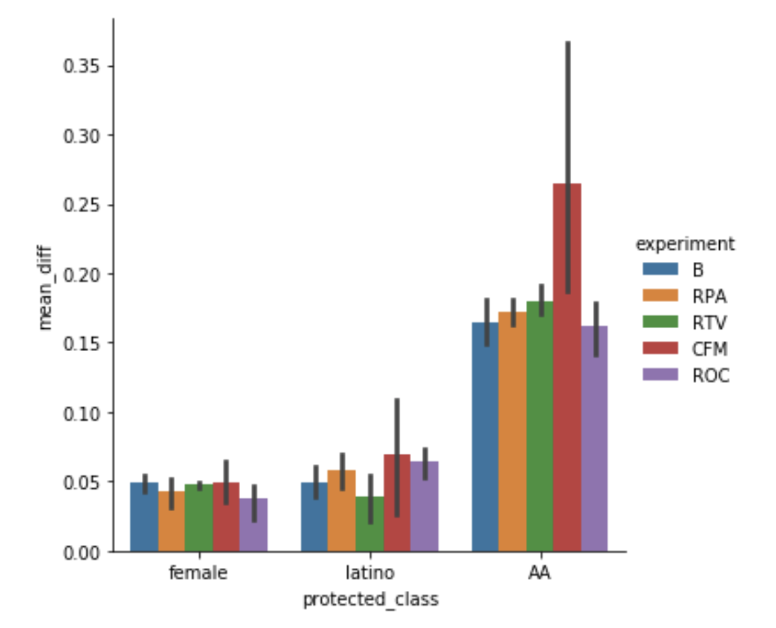
LogisticRegression DecisionTree RandomForest

